Slide 1
Impact of Car Features on Price and Profitability.
By: Mohak Bidaye

Slide 2
Project Description
As the automotive industry evolves, there is an increased focus on fuel efficiency, sustainability, and innovation. As competition rises, manufacturers must optimize pricing and product development to balance profitability and consumer demand.
My objective as a Data Analyst is to analyze the relationship between car features, market categories, and pricing and provide insights that can help the manufacturer optimize pricing and product development.

Slide 3
Approach
Firstly I downloaded the dataset
Gained an understanding of the data
Cleaned and dealt with missing data
The given tasks were carried out and required insights were gathered using data analysis
An interactive dashboard was created

Slide 4
Tech Stack Used
Microsoft Excel 2019
Microsoft PowerPoint 2019

Slide 5
Data Description
The variables in the dataset are:
Make: the make or brand of the car
Model: the specific model of the car
Year: the year the car was released
Engine Fuel Type: the type of fuel used by the car.
Engine HP: the horsepower of the car's engine
Engine Cylinders: the number of cylinders in the car's engine
Transmission Type: the type of transmission (automatic or manual)
Driven Wheels: the type of wheels driven by the car (front, rear, all)
Number of Doors: the number of doors the car has
Market Category: the market category the car belongs to (Luxury, Performance, etc.)
Vehicle Size: the size of the car
Vehicle Style: the style of the car (Sedan, Coupe, etc.)
Highway MPG: the estimated miles per gallon the car gets on the highway
City MPG: the estimated miles per gallon the car gets in the city
Popularity: a ranking of the popularity of the car (based on the number of times it has been viewed on Edmunds.com)
MSRP: the manufacturer's suggested retail price of the car

Slide 6
Data Cleaning and Preprocessing
There were a total of 16 columns.
The total number of rows was 11915.
There were 715 duplicate values and these duplicate values were removed.
Empty cells were deleted.
Blank rows of the Engine cylinders column for electric cars were imputed.
Highway mpg 354 was deleted as it was an outlier.

Slide 7
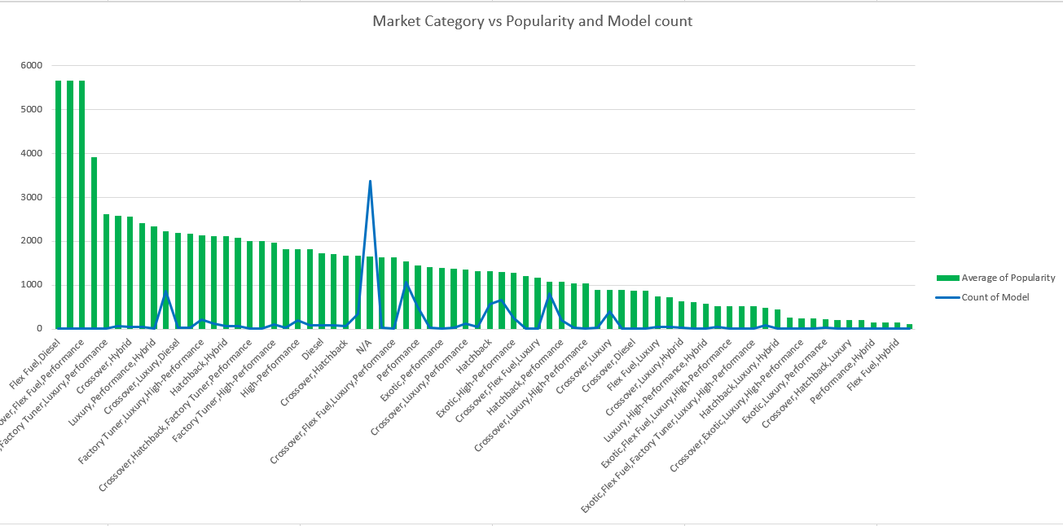
INSIGHTS: Task 1:
Insight Required: How does the popularity of a car model vary across different market categories?
The car models in the categories “Flex Fuel, Diesel”, “Hatchback, Flex Fuel”, “Crossover, Flex Fuel Performance” have the highest average popularity.
Categories like “Performance, Hybrid” and “Flex Fuel, Hybrid” have the lowest average popularity.

Slide 8
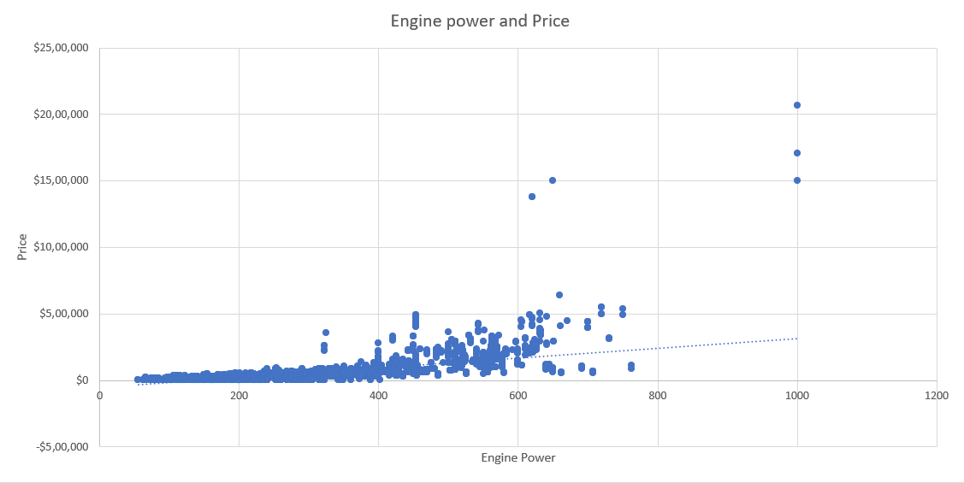
Task 2: Insight Required: What is the relationship between a car's engine power and its price?
A positive linear relationship is displayed between Cars Engine Power and Price.
Due to a more complex level of design, the higher the engine power, the higher the price.

Slide 9
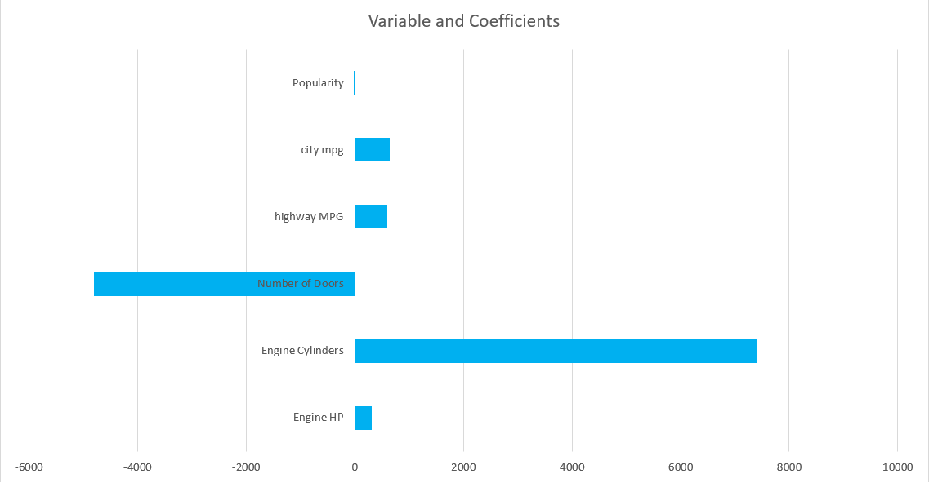
Task 3: Insight Required: Which car features are most important in determining a car's price?
The chart reveals that Engine Cylinders has the most significant positive influence on a car's price, with the highest coefficient.
On the other hand, the Number of Doors has a negative impact.
The variables City MPG, Highway MPG, and Engine HP show a smaller positive relationship with price.

Slide 10
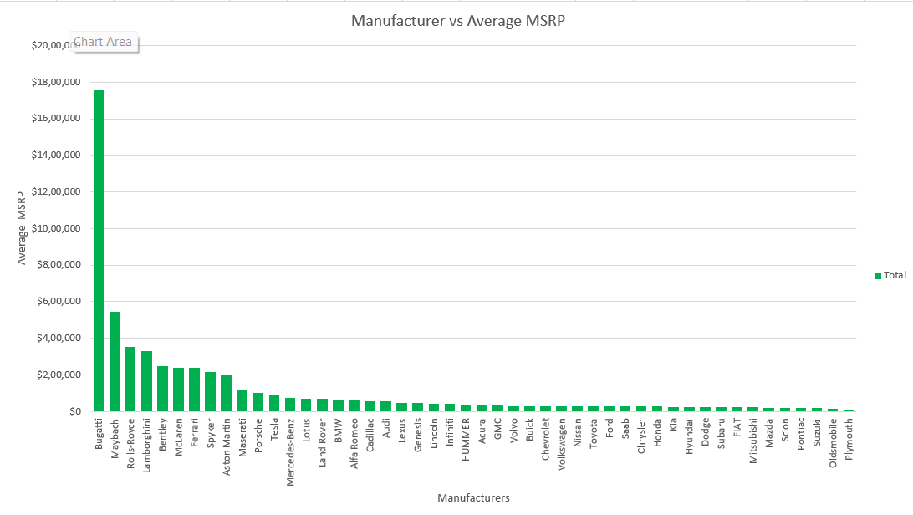
Task 4: Insight Required: How does the average price of a car vary across different manufacturers?
Bugatti is the manufacturer with the highest average price. Maybach, Rolls-Royce, Lamborghini, and Bentley follow this.
We can see that brands like Suzuki, Oldsmobile, and Plymouth have the lowest average price.

Slide 11
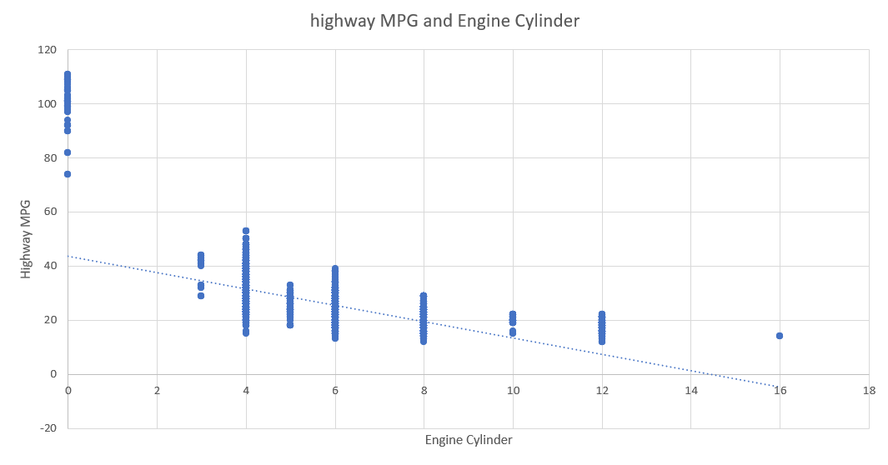
Task 5: Insight Required: What is the relationship between fuel efficiency and the number of cylinders in a car's engine?
The overall trend shows that highway MPG tends to decrease as the number of cylinders increases.
Correlation Coefficient
-0.65644
The correlation coefficient of -0.6564 indicates a negative correlation between the number of cylinders in a car's engine and its highway MPG

Slide 12
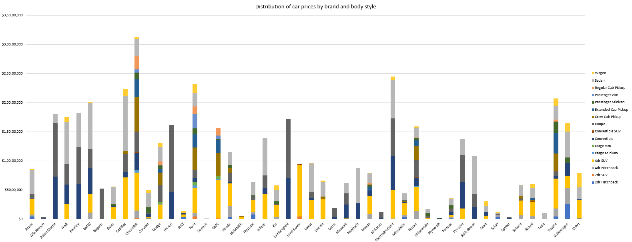
Dashboard Analysis Tasks
Task 1: How does the distribution of car prices vary by brand and body style?
Brands like Bugatti, Rolls-Royce, and Bentley are the most expensive cars and they dominate the high-price range.
SUVs and sedans are the most common body styles. They are offered by almost every brand; this covers a wide range of prices.

Slide 13
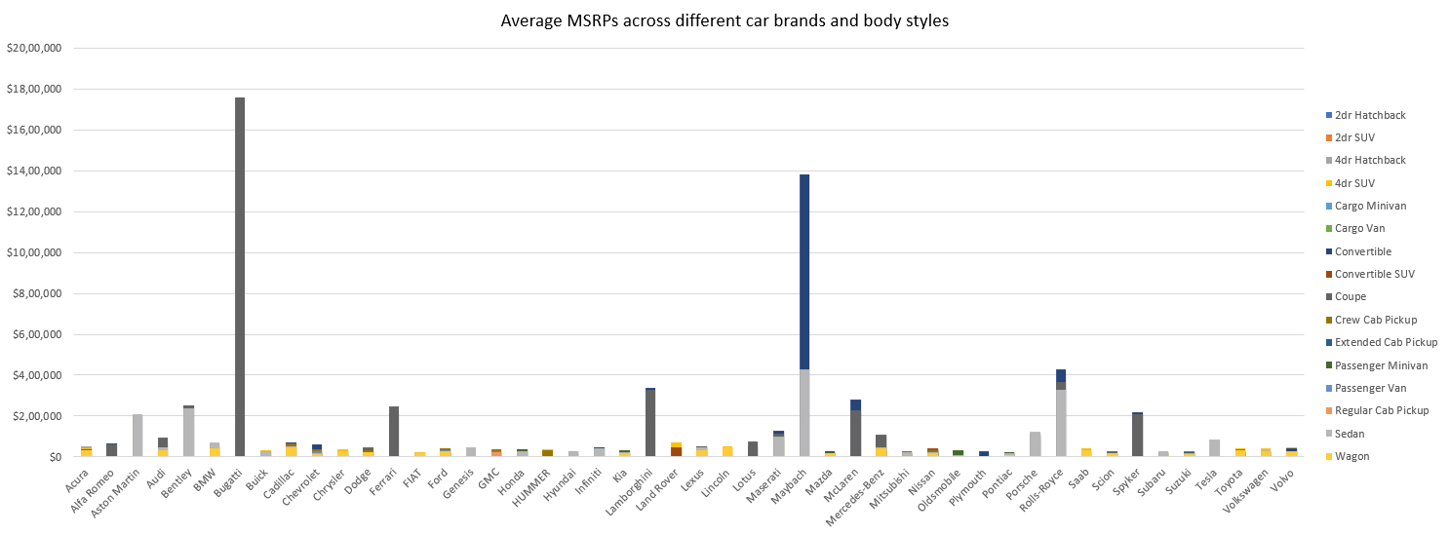
Task 2: Which car brands have the highest and lowest average MSRPs, and how does this vary by body style?
Bugatti and Maybach have the highest MSRP mostly for luxury sedans and coupes. They are followed by Rolls-Royce and Lamborghini.
Brands like Kia, Hyundai, and Fiat have the lowest and most budget-friendly options for sedans, hatchbacks, and SUVs.
There is a wide price range for SUVs and sedans while coupes and convertibles are on the more expensive side, especially for high-end brands.

Slide 14
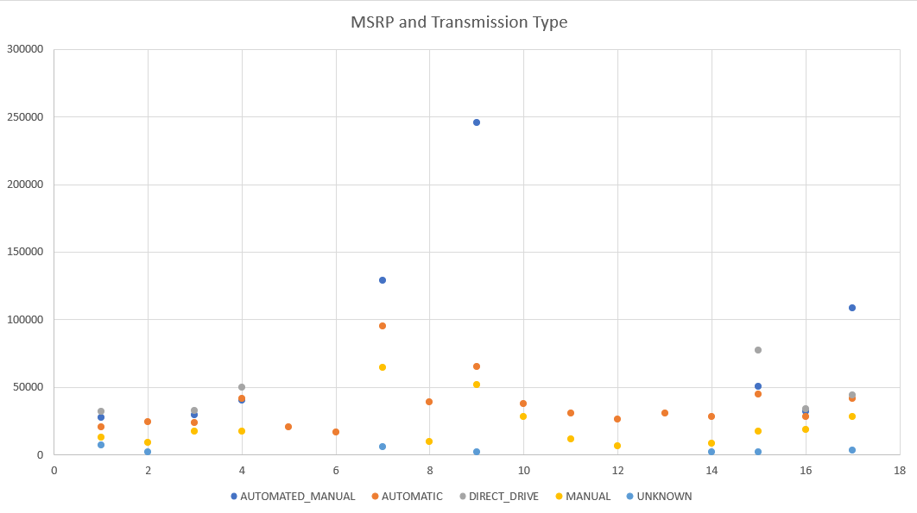
Task 3: How do the different feature such as transmission type affect the MSRP, and how does this vary by body style?
Transmissions like Automated Manual and Direct Drive mean a higher price, on the other hand, Manual cars are generally cheaper.
Sports cars and luxury sedans have a higher price due to their high-end transmissions while SUVs and regular sedans that use simple automatics are cheaper.

Slide 15
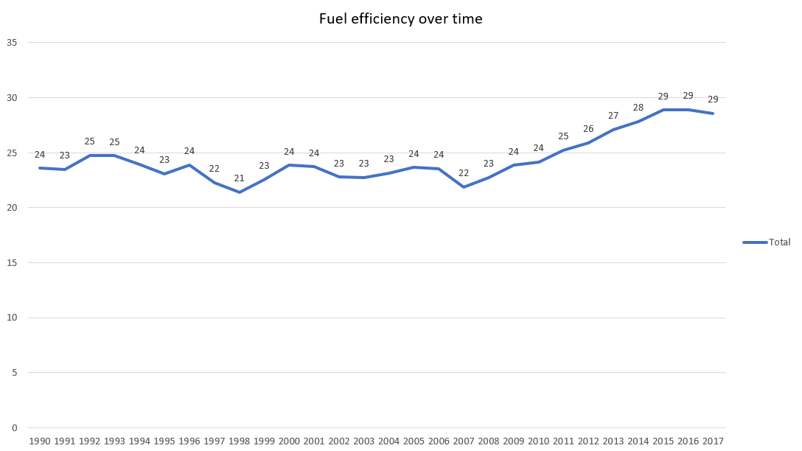
Task 4:How does the fuel efficiency of cars vary across different body styles and model years?
Fuel efficiency has generally improved over the years, especially after 2005, likely due to stricter environmental regulations and better technology.

Slide 16
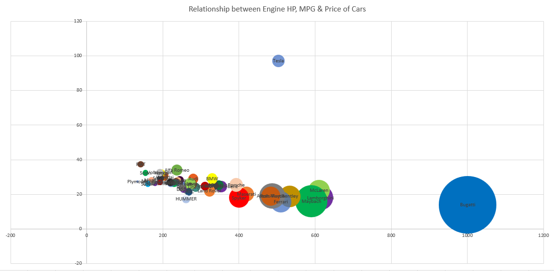
Task 5:Finding how does the car's horsepower, MPG, and price vary across different Brands?
High-end brands like Bugatti, Ferrari, Lamborghini, Maybach, and Mclaren have high prices and high horsepower but low MPG.
Tesla stands out with high fuel efficiency and moderate horsepower since it’s electric.
Brands like BMW, Audi, and Chevrolet have moderate horsepower, moderate MPG, and price resulting in balanced performance and efficiency.

Slide 17
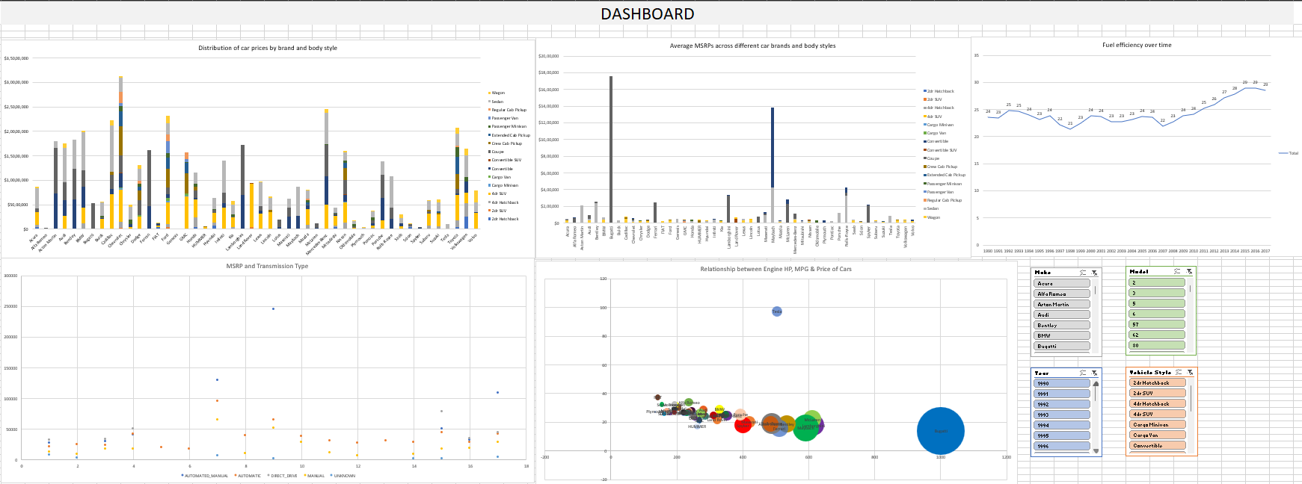
DASHBOARD

Slide 18
Results
Flex Fuel and Crossover Vehicles dominate the market. This makes them reliable for new manufacturers entering the industry.
Higher engine power results in higher costs due to design complexity.
There is a negative correlation between the number of cylinders and fuel efficiency.
Manufacturers aiming for fuel efficiency should prioritize lower-cylinder engine designs.
SUVs, Sedans, Coupes, and Convertibles are some of the most popular vehicle styles in the market.
Manual transmission type vehicles are more affordable while Automated Manual and Direct Drive type vehicles increase the price.
Electric vehicles are growing in demand due to sustainability and efficiency.

Slide 19
Conclusion
The insights gained from this project help guide car manufacturers that want to optimize pricing and product development strategies.
This project gave me a great understanding of the automotive industry by exploring trends in, car features, pricing, fuel efficiency, and what customers prefer.
It helped me see how technology and market demands shape the kinds of cars manufacturers produce and how they price them.

Slide 20
Links
Excel File:
https://docs.google.com/spreadsheets/d/1jp-_gezZkcrTLwQgSiUwrS6TK5GKbzjY/edit?usp=drive_link&ouid=109524556463170667809&rtpof=true&sd=true

